Slide 1
E-customer analysis
Notes:
E-Customer analysis is a critical component of any business plan in all stages of growth. When you analyze your customers, you define who your target market is, and decide how you’ll reach them. A recent article in Forbes stated that 81% of enterprises rely on analytics to improve their understanding of customers. Where will you start?

Slide 2
- Profile of potential customer for enterprises - Tools to analyze E-customers - E-customers relations
Notes:
This chapter presents the characteristics of an e-customer from the point of view of creating new business enterprises which are based on network, virtualisation and knowledge.
Context:
From the point of view of an e-enterprise and its marketing activity a through knowledge of an e-customer is a must. E-users are a new and vast group of e-enterprise stakeholders. Which customer segment or customer category to target? A knowledge of techniques of identification and segmentation of e-customers is a challenge and a crucial condition for effective and successful functioning of an e-enterprise.
Concept:
An e-customer is anyone who, under various internal and external circumstances, decides to buy online an item or a service, purchases it and, finally, consumes it. However, in some circumstances, an e-customer may also be considered someone who chooses and pays for a product online but does not necessarily consume the purchase.

Slide 3
Categories of e-customers:
Convenience buyer
Savings buyer
Notes:
Convenience buyer :
usually buys on the same websites and the same categories of products – this way of buying saves their time
does not want to learn to use new navigation tools or leave their personal details on new websites even though it may mean higher prices for their purchase
suffers from a lack of time and thus they value their time more than money
various bonuses or special offers do not motivate them to change the website they buy on
Savings buyer:
- ready to do the shopping on other websites if they offer better prices
- does not get discouraged with new navigation tools or filling in additional registration forms if in exchange they can get a better price
- is encouraged with special offers and bonuses

Slide 4
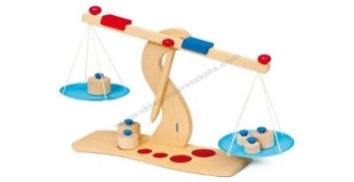
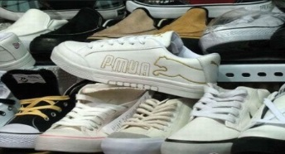
Categories of e-customers:
Comparison buyer
Loyal buyer
Notes:
Comparison buyer:
- likes comparing and analysing the offers before making the decision on which website to choose for their shopping
- they regard the whole transaction as an offer, i.e. the choice of products, the price of the product, cost of delivery, special offers and so on.
Loyal buyer:
- would usually buy on the same trusted websites, they are not interested in moving elsewhere
- are not willing to buy on unknown websites out of comfort rather than convenience
- to them, the Internet is a source to look for bargains

Slide 5
Categories of e-customers:
Focused buyer
Aversive buyer
Notes:
Focused buyer:
- buys on the Internet with a clear goal, unemotionally
- chooses particular websites for particular products
- finalises the purchase and does not get tempted by special offers, ignores advertisements and banners
- does not waste their time on looking for best prices or bargains
Aversive buyer:
- does not like shopping in regular shops
- online shopping is a way of escaping the crowd, queues and shopping environment they do not like
Other categories of e-customers may be selected based on their experience and place on the learning curve

Slide 6
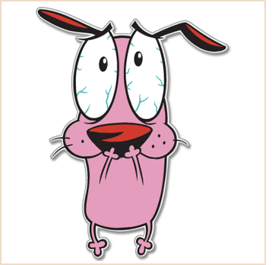
Categories of e-customers:
Intimidated buyer
Adventurous buyer
Notes:
Intimidated buyer:
- 0-9 month experience
- usually operates carefully, does not like new territories
- does not feel comfortable using the Internet and is afraid of making a mistake
- becomes a client only after some time and after reaching a certain level of comfort.
Adventurous buyer:
- 9-18 month experience
- surfs the Internet easily, gained exploring skills
- talks about the Internet with friends, notices advertisements, reads other users’ opinions
- is constantly looking for better offers, better prices and more convenient transactions
- while gaining more practice they shape certain habits and preferences

Slide 7
Customer Analytics Tools for Every Business Size
The more you know about your customers, the likelier you are to be able to make them happy.
Notes:
The more you know about your customers, the likelier you are to be able to make them happy. This is the idea behind customer analytics, which according to Gartner, means using data in order to gauge customer sentiment and satisfy their needs. The idea of using data might be a scary one for small businesses, but customer analytics tools can be found in surprising places that you might not even realize. From CRM to social media listening, you may already be using customer analytics tools that can give you insight into your customers.

Slide 8
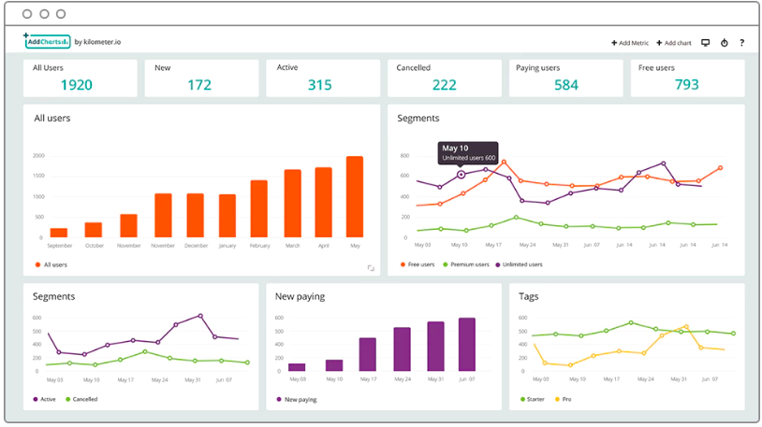
4 different types of software categories
-CRM
-Customer service
-Social Media
-Analytics
Notes:
We go go through 4 different types of software categories for beginners, intermediate, and advanced users, depending on how much data you need to analyze, as well as how much time and money you want to invest in customer analytics.
CRM: A lot of CRM software already includes analytics features that can be used to glean insight into customers.
Customer service: Some customer service software has reporting and insights that can give you a detailed look into your customers.
Social media: If you want to gain insight into what your customers are saying outside the realm of your own website, you can use social media tools for listening on other sites.
Analytics: Fully dedicated analytics solutions designed specifically for customer analytics can give useful insight by pulling data from a variety of sources.

Slide 9
CRM: Zoho CRM
Zoho uses data from its own Zoho CRM.
Its reporting features will give you an overview of your most successful marketing campaigns.
Notes:
Zoho uses data from its own Zoho CRM, as well as pulling in data from other Zoho products and third-party apps for its customer analytics. Its reporting features will give you an overview of your most successful marketing campaigns, your most valuable customers, and which leads need nurturing. You can also create your own formulae to get reports tailor-made to your specific needs, as well as da shboards that will give you a high-level overview of your data.

Slide 10
Customer Service: Intercom
Intercom is a customer service and messaging platform to keep track of and stay in touch with customers. It lets you start the communication process with live chat.
Notes:
Intercom is a customer service and messaging platform to keep track of and stay in touch with customers. It lets you start the communication process with live chat, and then progress customers through to conversion with lead tracking and marketing automation. Because it keeps track of all of this data within the system, it lets you drill down at the customer-level to send targeted messages to customers at varying stages of the customer journey. It also provides an overview of customer segments and Intercom activity for bigger-picture data.

Slide 11
Analytics: Kissmetrics
As a web and analytics platform, Kissmetrics provides valuable insights into web visitors and how they're interacting with your site, including where they're clicking
Notes:
As a web and analytics platform, Kissmetrics provides valuable insights into web visitors and how they're interacting with your site, including where they're clicking, and at what stage they decide to leave. Giving you data about customer behaviour, you can create behavioural marketing campaigns targeted at distinct user groups. Putting unique user data together, you'll be able to create segments of users to target based on their profiles and which stage they're at in the customer experience journey for a higher conversion rate.

Slide 12
Customer Service: CloudCherry
CloudCherry is a customer experience and analytics tool that'll give you deep insights into your customers.
Notes:
CloudCherry is a customer experience and analytics tool that'll give you deep insights into your customers. A platform for collecting customer insights via email, web, and smartphone surveys, CloudCherry collects and collates data from every channel and interaction that customers have with your company. The results that it delivers will give you actionable ways to help improve the customer experience journey and retain more customers.

Slide 13
Analytics: BIME by Zendesk
The popular customer service solution Zendesk offers an analytics tool in the form of BIME. BIME pulls in customer experience data from a variety of different sources including Google Analytics, Adwords, Salesforce, and Zendesk
Notes:
The popular customer service solution Zendesk offers an analytics tool in the form of BIME. BIME pulls in customer experience data from a variety of different sources including Google Analytics, Adwords, Salesforce, and Zendesk, presenting it in dashboard form to give a high level overview of performance and customer segments. From there, you can drill down to get useful information about the success of campaigns, how customers interact, and when they're more likely to convert. Its forecasting and reporting features also help predict future sales figures to help you make the right business decisions.

Slide 14
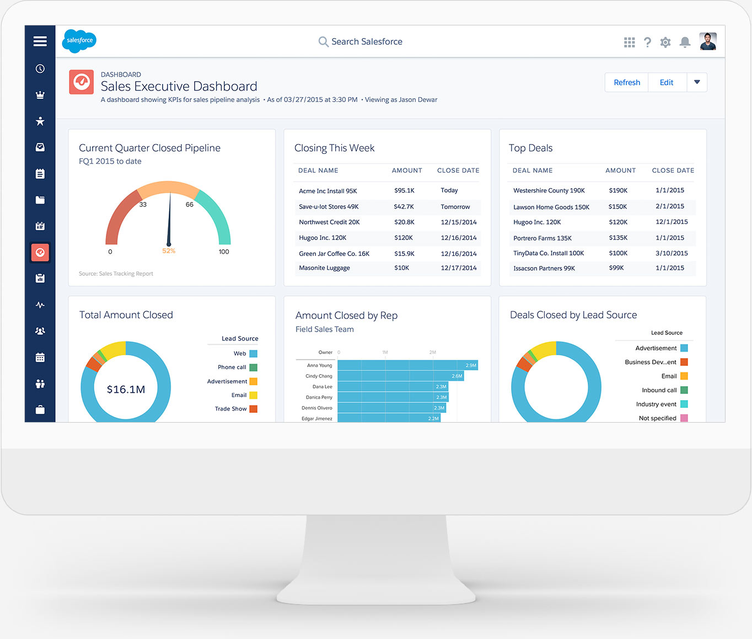
CRM: Salesforce Sales Cloud
Salesforce's popular sales and CRM software has added power to its offering with Einstein, an AI (artificial intelligence) component to give deeper insights into customers
Notes:
Salesforce's popular sales and CRM software has added power to its offering with Einstein, an AI (artificial intelligence) component to give deeper insights into customers, a better overview of the sales pipelines, and more predictive sales data. Einstein scores leads based on their likeliness to convert, prioritizes opportunities first, and then gives recommendations on the best ways to follow up, taking into consideration customer history, in order to close the deal.

Slide 15
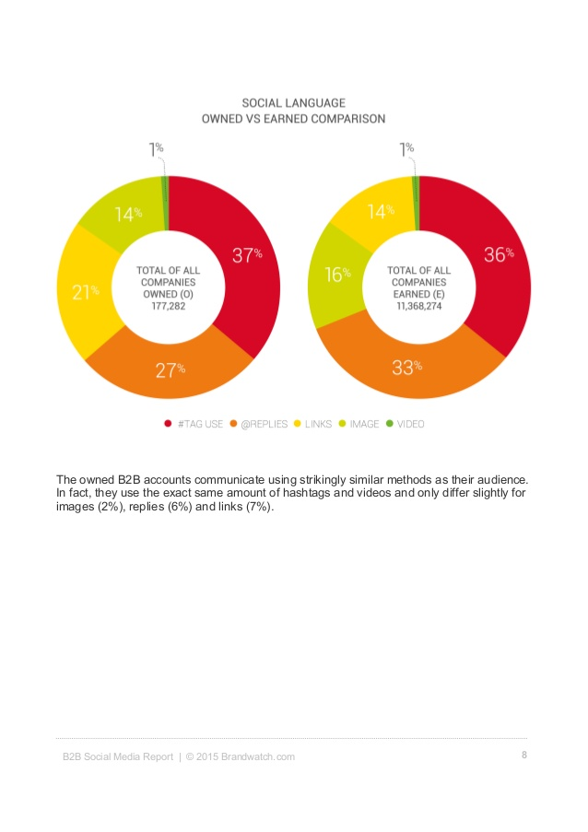
Social media: Brandwatch
Brandwatch is a deep listening and social media monitoring tool that lets you track mentions across social media, as well as get insights into what conversations are happening around your product, service, or industry.
Notes:
Social media: Brandwatch
Brandwatch is a deep listening and social media monitoring tool that lets you track mentions across social media, as well as get insights into what conversations are happening around your product, service, or industry. By setting up and sending queries, you can get social intelligence on certain terms, twitter handles, or even individual sources.

Slide 16
Customer analytics tools will make your customers happy
Notes:
Customer analytics tools will make your customers happy
Whether you're just starting off, or are looking to get more into customer analytics, the end result will be the same: giving your customers more of what they want and keep them coming back.
Says Shep, "when you start to be able to predict behavior and deliver an experience based on what we know the customer liked before and what they're going to like, I think you've got a really strong opportunity to engage with them and start to build a loyal relationship. People love to do business with companies that they know, like, and trust. When I feel that a company knows me so well that I want to do business with them over and over again as a result of that, I think that's pretty powerful."

Slide 17
E-customer relation Ethics code The ethics code is an integral part of a company values, so it helps to be consistent in how to respond to customer service situations.
-We Are Here Because of Our Customers
-We Understand Our Customers Are Our Future
-We Treat Customers Like Family
-We Always Listen to Our Customers
-We Work Hard to Solve Any Problems
-We Maintain Positive Attitudes
-We All Impact Customer Service
Notes:
The ethics code is an integral part of a company values, so it helps to be consistent in how to respond to customer service situations.
We Are Here Because of Our Customers.
The customer must always come first. One happy customer may tell a few people about their service experience; however, the unhappy ones will tell everyone in their circles (it’s a small world with social media). Some research estimates that it takes twelve positive service incidences just to make up for one negative incident.
We Understand Our Customers Are Our Future.
Even the world's most successful companies can't take survival for granted. When your customers needs change, change to meet those needs. Abandon the status quo and push beyond your comfort zone. And be grateful that your customer base changes—because stagnation leads to death

Slide 18
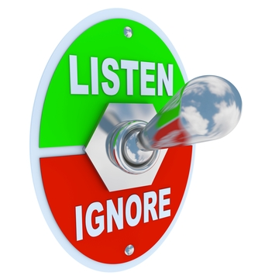
Treat Customers Like Family.
Always Listen to the Customers.
Notes:
Treat Customers Like Family.
Don't see your customers as walking wallets; make them feel special. Learn to love them, because they're the ones who keep your company alive. Build rapport. Be fully present when you're with them. Learn their special dates, so you can send cards or say Happy Birthday. Take notes on their families and hobbies. They'll be very grateful for your concern—and that gratitude will translate to profit.
Always Listen to the Customers.
We listen when they are happy, dissatisfied, or say nothing. We always ask about service quality so we can do better next time. Pay attention to their needs; make a special effort to hear what they're saying. Don't just go on autopilot. Focus on them and give them all of your attention, proving they're important to you. The biggest reason people leave a company is because they sense the company doesn't care about them anymore. Never let that happen. Make them so happy they sing your praises, drawing in others.

Slide 19
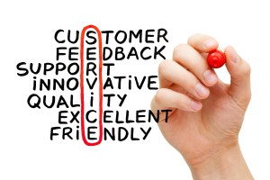
E-customer relation Ethics code
Positive attitude
Work hard to
solve problem
Notes:
We Work Hard to Solve Any Problems.
When a customer has a problem, you have a problem. Don't let yourself be satisfied until they are; give 110 percent to settle their problem, so you can retain their business. Most customers will do business with you again if you fix their problem; it’s even better if you fix it on the spot. They want to feel important, and they want you to be fully prepared to help them.
We Maintain Positive Attitudes.
Even with difficult customers, keep your attitude relentlessly positive. The smile on your face and the tone of your voice can make a huge difference. Accept that even if their experience is perfect, they probably won't comment on it, because they expect perfection. And remember, their attitudes will change over time. What was once good enough may become unsatisfactory if they encounter something better. So give them that something better—and do it with a smile. All it takes is one indifferent employee to kill your business.

Slide 20
E-customer relation Ethics code Everyone in your company, no matter how minor, impacts customer service. I once visited a neighborhood restaurant where the service was great and the food was wonderful. I had a great time—until I felt a wad of chewing gum on the underside of the table, which completely killed the experience for me. I didn't go back there, despite the otherwise wonderful atmosphere. The cleaning crew had let everyone down. Little things and small actions can stick in the customer's mind, damaging their experience.
Notes:
We All Impact Customer Service.
Everyone in your company, no matter how minor, impacts customer service. I once visited a neighborhood restaurant where the service was great and the food was wonderful. I had a great time—until I felt a wad of chewing gum on the underside of the table, which completely killed the experience for me. I didn't go back there, despite the otherwise wonderful atmosphere. The cleaning crew had let everyone down. Little things and small actions can stick in the customer's mind, damaging their experience.
Embrace and believe in this code and you'll have a better chance of surviving the changes that constantly wash through the business environment.

